Slide 1
Doing research
Community research training #1
Notes:
Hello and welcome to the first of our community research training presentations which is going to be about the basics of doing research. I am Marina from Bridge: A Mindsport for all and in today I am going to give you an overview of what research is, the main types of research that you can undertake, and why research matters. Don’t worry if you’ve never done community research before – in this brief talk, I will outline everything you need to get started and I will share with you some examples of community research at the end to give you some practical examples of how community research is done and show you just how much impact you can achieve through community research.

Slide 2
What is research?
Research is the purposeful collection of data that is useful to describing or explaining different aspects of the world
We start with a research goal: “I want to know more about… (e.g. why do people like coffee so much?)
We then choose a research method (e.g. a survey or some interviews) and go about finding out more
Notes:
So what is research? I think that all of us have a good idea of what research is, but the basic premise is this: research is defined as the purposeful collection of data that is useful to describing or explaining certain aspects of the world and answering a research question. When we do research, we begin by coming up with a research goal and then choosing some research methods to help us reach our research goal. For example, we may want to know why people like coffee so much, and to go about finding out why that is the case, we can do an online survey with some coffee drinkers or we could go into a café and ask the people there just what is it about coffee that they find so enticing.

Slide 3
What is research?
After we analyse our data, we now have our findings, and we end up with something like this…
Coffee is a stimulant: it makes people more energetic and productive
There is a coffee-drinking culture in many countries around the world: coffee barely needs any marketing!
Cafes are important communal spaces and people want to be part of the coffee-drinking community
We have successfully answered our question and understood what is so special about coffee!
Notes:
Continuing on with our example about drinking coffee, once we have done our survey and interviews, we can compile and analyse our data to find some similarities between the responses of everyone we’ve spoken to. We now have our findings, which may look like this: first, we conclude that coffee is a stimulant because people have told us that drinking coffee makes them feel more energetic and productive; second, we find that there is a coffee-drinking culture in many countries around the world as we have surveyed people internationally and we have found that there are cafes everywhere and that people frequently visit those due to the convenience and the wifi; third, our research participants have told us that they value the social aspect of coffee drinking sense of community that they get by drinking coffee with work colleagues or with friends. By purposefully collecting data to answer our research question, we achieved our research goal of finding out more about the cultural significance of coffee.

Slide 4
Research is not just for people in white lab coats…
You have probably used your research skills to:
Choose your next holiday destination
Compare prices and services online
Find the best way to learn a new language
Find a good movie to watch
You already know how to do research (for the most part)!
Notes:
Now, in the coffee research example we’ve just talked about, you may imagine that you would need quite specialised research skills and formal training to carry out the research effectively, but that is not necessarily the case, as research is not just for people in white lab coats, and in fact, people do informal research on an everyday basis for all sorts of things. In the last year alone, you have probably done several instances of research, for example, to Choose your next holiday destination, Compare prices and services online, Find the best way to learn a new language, or Find a good movie to watch. You may have done desk-based research to reach a decision, or you may have spoken to friends to get recommendations; in either case, you have gone through lots of information and compared different bits of data to produce an answer to your question. That means that you already know how to do research, for the most part!

Slide 5
The scientific method
Observe the natural (and social) world
Question why things are the way they are
Gather data and answer your research question
Be willing to consider new evidence (things do not stay the same)
Minimise assumptions
Change what you thought you knew to be true
Notes:
Indeed, people are naturally curious, and we have been doing research in one way or another since many centuries ago, though the formal and rigorous way of doing research, called the scientific method, originated as early as the 17th century, and some key principles for doing research “the right way” were established. The key principles of the scientific method (as researchers used to see them back then) were that: we as people are observers of the natural and social world, and we may come to question why things are the way they are, or how they could be. Once we do start to question things, then we need to gather data to answer our research questions, and we need to be willing to consider new evidence on an on-going basis and update our understanding as things do not stay the same over time. Researchers at the time also came to see that we are also biased observers of the world with our own subjective ways of viewing and interpreting it and as argued that we need to try to minimise our assumptions and allow ourselves to be convinced by the evidence that we collect. So there came to be a sort of preference towards personal neutrality and letting the data do the talking.

Slide 6
Types of research
Quantitative
20% of people bought ice cream today
Numbers, percentages
Qualitative
“I bought the ice cream because it was a hot day”
What, where, how, why?
Notes:
Since the 17th century, a lot has changed, and while some of the earliest research done back then was empirical, and concerned with numbers and percentages, we now have two established types of research: quantitative and qualitative. If a quantitative researcher wants to do some research on ice cream consumption, they may be most interested in drawing up some percentages of how many people bought ice cream on a given day. If a qualitative researcher is interested in that same question, though, they might want to speak to people to find out what motivated them to get ice cream and asking them open questions such as what, where, how and why? They may then find, for example, that people bought ice cream because it was a hot day. These findings provide some context to the matter of ice cream consumption that was not fully addressed by the quantitative research. The qualitative research, however, cannot be generalised to the whole population. It is only specific and local to the setting in which you asked people about their ice cream consumption. That is why some researchers (such as myself) think that combining quantitative and qualitative research is oftentimes the best way to go.

Slide 7
The research process
Conduct a literature review
Formulate a research question
Choose research methods
Collect and analyse data
Interpret the findings and draw conclusions
The link between dog ownership and one’s levels of happiness
Dog ownership is beneficial to one’s mental and physical health
How does dog ownership influence happiness?
Interview dog owners to get an idea of their views and experiences
Conduct 10 interviews and find patterns between the responses
Notes:
No matter whether you choose quantitative, qualitative or mixed research, the research process is similar in all cases. For instance, a researcher who wants to study the link between dog ownership and happiness would first start by conducting a literature review to see what other researchers have found on this topic so as to not reinvent the wheel, and they will then formulate a specific research question such as “How does dog ownership influence happiness?”. They will choose their research methods, and maybe interview dog owners to get an idea of their views and experiences on dog ownership, and they would then collect and analyse their data by conducting 10 interviews and looking for similarities and differences between the dog owners’ responses. Finally, they will interpret their findings and draw some conclusions, and as we all know, they are most likely to conclude that Dog ownership is beneficial to one’s mental and physical health as dogs are great.

Slide 8
Key concepts
Research participants
Research data
Research findings
The people who take part in our research
The information we gather from our participants
The patterns we identify across the information we have collected
Notes:
Some key concepts in the research process are research participants who are the people who take part in our research, the research data, which is the information we gather from our participants, and the research findings, which are the patterns we identify across all the information we have collected. So there is a transformation that occurs here, first we have the spoken word of our participants (if we are doing interviews or focus groups) which we transform into one big pile of research data, and which we then engage with analytically to turn into research findings. Usually, if we only ask one person about our research topic, then that is not research data, but once we have asked several people, we can begin to treat their responses as data and as being a bit more representative of the general population.

Slide 9
Doing research well
Good research follows a systematic approach.
Researchers need to practice ethics and follow a code of conduct.
Accuracy is one of the most critical aspects of research.
Similar questions are posed to the participants to allow for comparison.
Participants are asked to consent to take part in the research, and the purposes of the research are explained to them.
Real-time data and knowledge is derived from real-world settings.
Notes:
In order to do research well, we need to ask all of our participants somewhat similar questions, so that we can be sure that all of them are thinking about the same research topic. For example, if I ask one of my participant about their coffee drinking habits, and I ask another participant how often they like to take their dog out for a walk to the café, then the second participant may end up telling me more about their dog walking habits than their coffee drinking habits. So it is important that we ask similar questions, as this will allow us to reasonably compare the responses that we get. We also need to ask our participants if they consent to take part in the research before doing the research, and explain what the research is about, so that they can decide if they want to participate or not. It would not be fair and ethical if we took their responses without their permission and presented them word for word at a conference, so we do need to ask for explicit permission from them to use their data for research purposes. Accuracy is one of the most critical aspects of research, so we would record participants’ responses as they were given, and we would not alter the data in any way, as this would then not be data anymore and it would be more a work of fiction.

Slide 10
Why do we do research?
To expand our understanding of our area of interest
To get an up-to-date snapshot of how things are
To generate positive impact and bring about change
Notes:
So we see that there are some key steps and principles involved in doing research, but why is it that we do research? Well, the main benefits are that we get to expand our understanding of our area of interest, and we get to have the latest information on how things are, and on those grounds, we are also in a good position to make a positive impact to the world in some way and bring about change. The best research is research that tells us something brand new about the world, and research that is recent and therefore current and actionable, and if we have such original and recent research evidence in place, then we are also in a good position to make a positive impact.

Slide 11
Community research
By carrying out their own research, community researchers create positive change in their own community.
Community researchers have first-hand experience of the research setting that researchers may lack.
Community researchers have insider knowledge and relationships that help them bring unique perspectives to the research.
Notes:
Speaking of positive impact, one particularly impactful kind of research is community research. In community research, members of a community are invited to undertake their own research and in doing so, generate their own impact that benefits them directly. Community research is very important because Community researchers have first-hand experience of the research setting that researchers may lack. Community researchers also have insider knowledge and relationships that help them bring unique perspectives to the research. For example, if you are a coffee drinker or a dog owner, then you may already know other people who are similar to yourself, and who are also coffee drinkers or dog owners. These people will go to the same places you go, so you don’t really need to think so much about recruiting participants or building a new connection from scratch because you already have so much in common with your research participants, and doing research for you in this context will be a breeze.

Slide 12
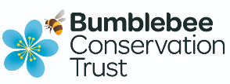
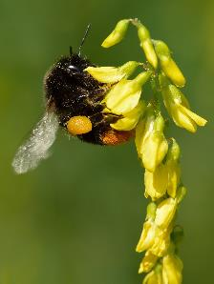
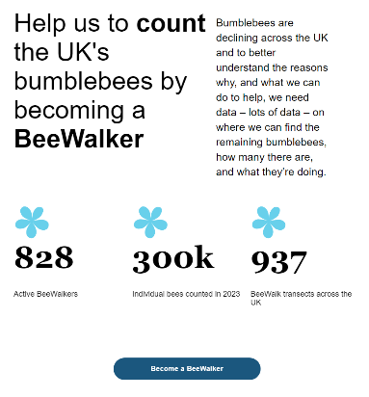
Some examples…
The Bumblebee Conservation Trust (BBCT) was launched at the University of Stirling in 2006.
It was aimed at bridging the gap between research findings and conservation practice.
The research showed that bumblebees thrive on islands.
BBCT has involved >12,000 people in bumblebee recording and conservation.
Members of the public helped the research by becoming BeeWalkers.
Notes:
One good example of community research that was done at my university, the University of Stirling, was the research launched by the Bumblebee Conservation trust in 2006. The Bumblebee Conservation Trust (BBCT) is a conservation charity that aimed to bridge the gap between research findings and conservation practice. The research involved over 12,000 people in bumblebee recording and conservation, and found that bumblebees thrive on islands. As a result, we now have a clear idea how to conserve bumblebees; we know that they simply need enough of the right flowers, at the right times of year, provided in a concentrated area. If it had not been for the community researchers, then this research may not have progressed and made an impact as quickly, or it may not even have been possible.
https://impact.ref.ac.uk/casestudies/CaseStudy.aspx?Id=44019

Slide 13
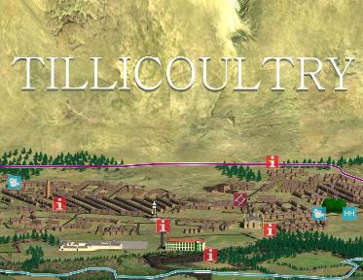
Some examples…
Through the History Tomorrow initiative, researchers at the University of Stirling designed a research project to restore property of the past to communities.
Community volunteers were trained and empowered to undertake their own research into public history.
The research enhanced local awareness about areas of historic and cultural significance and informed community participation in local planning debates.
22 different community projects were funded through a £2M grant from the Heritage Lottery Fund
Image courtesy of https://ochils.org.uk/olp/index.html
Notes:
Another example, again from my university, comes from the History Tomorrow initiatives, which was developed to restore property of the past to various communities in Scotland. Community volunteers were trained and empowered to undertake their own research, and in doing so gained a sense of possession of public history and their `own' histories. The research had many positive outcomes – it enhanced local awareness about areas of historic and cultural significance, it informed community participation in local planning debates, and most significantly, 22 different community projects were funded through a £2M grant from the Heritage Lottery Fund as a result of the project.
https://impact.ref.ac.uk/casestudies/CaseStudy.aspx?Id=44275

Slide 14
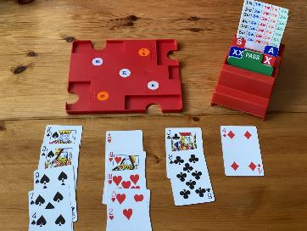
New community research project: Bridging schools
The “Bridging schools” research projects aims to encourage more young people to learn and play bridge.
According to an international survey of over 14000 bridge players, only 1.5% of all bridge players are between the ages of 13 and 24.
The goal of the project is to develop bottom-up solutions to promoting bridge in schools.
It is anticipated that the research and outreach activities will lead to a significant increase in the number of young bridge players globally.
Notes:
Following on from the best practice of these research examples, we at BAMSA are also keen to achieve positive impact through our new community research into youth bridge. As only 1.5% of all bridge players are classed as young players, we aim to encourage more young people to learn and play bridge, and to develop research evidence to support the promotion of bridge in schools. By understanding why young people play or do not play bridge, we anticipate that we will set up outreach activities that will ultimately lead to a significant increase in the number of young bridge players globally. That is where our community researchers come in, and so I hope that this presentation is useful in getting you started with community research.

Slide 15
Doing research
Community research training #1

